Slide 1
Senior Capstone
Software Issue & Change Management
Requirements Document
Donald Akujobi
Raymond Lemon
Amber Dawkins
Matthew King
Wayne State University

Slide 2
Topics
Software Requirements
Concept Attributes
Domain Model

Slide 3
Responsibilities
Responsibility Description | Type | Concept Name
Rs1. Access to any part of the system, has the ability to add and remove accounts | D | Admin User
Rs2. Has Read –Only access in the System | NPU | Non-Privileged User
Rs3. Has Read & Write Access in the System | PU | Privileged User
Rs4. Read, Write, Update, and Delete information from the user | D | Database

Slide 4
Use Case 1:
Add New System
Use Case UC-1: |  |  | Add New System
Related Requirements: |  |  | REQ3, REQ5, REQ7, REQ9, REQ11
Initiating Actor: |  |  | Any of: Trusted Users, Admin
Actor’s Goal: |  |  | To add information for a new system to the repository
Participating Actors: |  |  | Database, Admin, Trusted Users
Preconditions: |  |  | Trusted User/Admin is currently logged in the system and is shown a hyperlink “Add New System.”
Postconditions: |  |  | The newly added system is now viewable to all visitors of the site
Flow of Events for Main Success Scenario:
→ | 1. | Trusted User/Admin clicks the hyperlink “Add New System”
← | 2. | System prompts the Trusted User/Admin for the Name, Version Control System URL, Issue Tracker URL, and Programming Language of the System
→ | 3. | Trusted User/Admin enters the system information and clicks submit
← | 4. | System updates the records in the Database
→ | 5. | System displays the updated information on the “View Systems” page

Slide 5
Use Case 2: View Systems
Use Case UC-1: |  |  | Add New System
Related Requirements: |  |  | REQ4, REQ6, REQ8, REQ10, REQ12
Initiating Actor: |  |  | Any of: Trusted Users, Public Users, Admin
Actor’s Goal: |  |  | To view information about the systems stored within the repository
Participating Actors: |  |  | Database, Admin, Trusted Users, Public Users
Preconditions: |  |  | Trusted User/Admin/Public User currently has access to the system and is shown a “View Systems” Hyperlink
Postconditions: |  |  | The systems information table of the database is viewable to all visitors of the site
Flow of Events for Main Success Scenario:
→ | 1. | Trusted User/Admin/Public User clicks the hyperlink “View Systems”
→ | 2. | System displays the most up to date information on the “View Systems” page

Slide 6
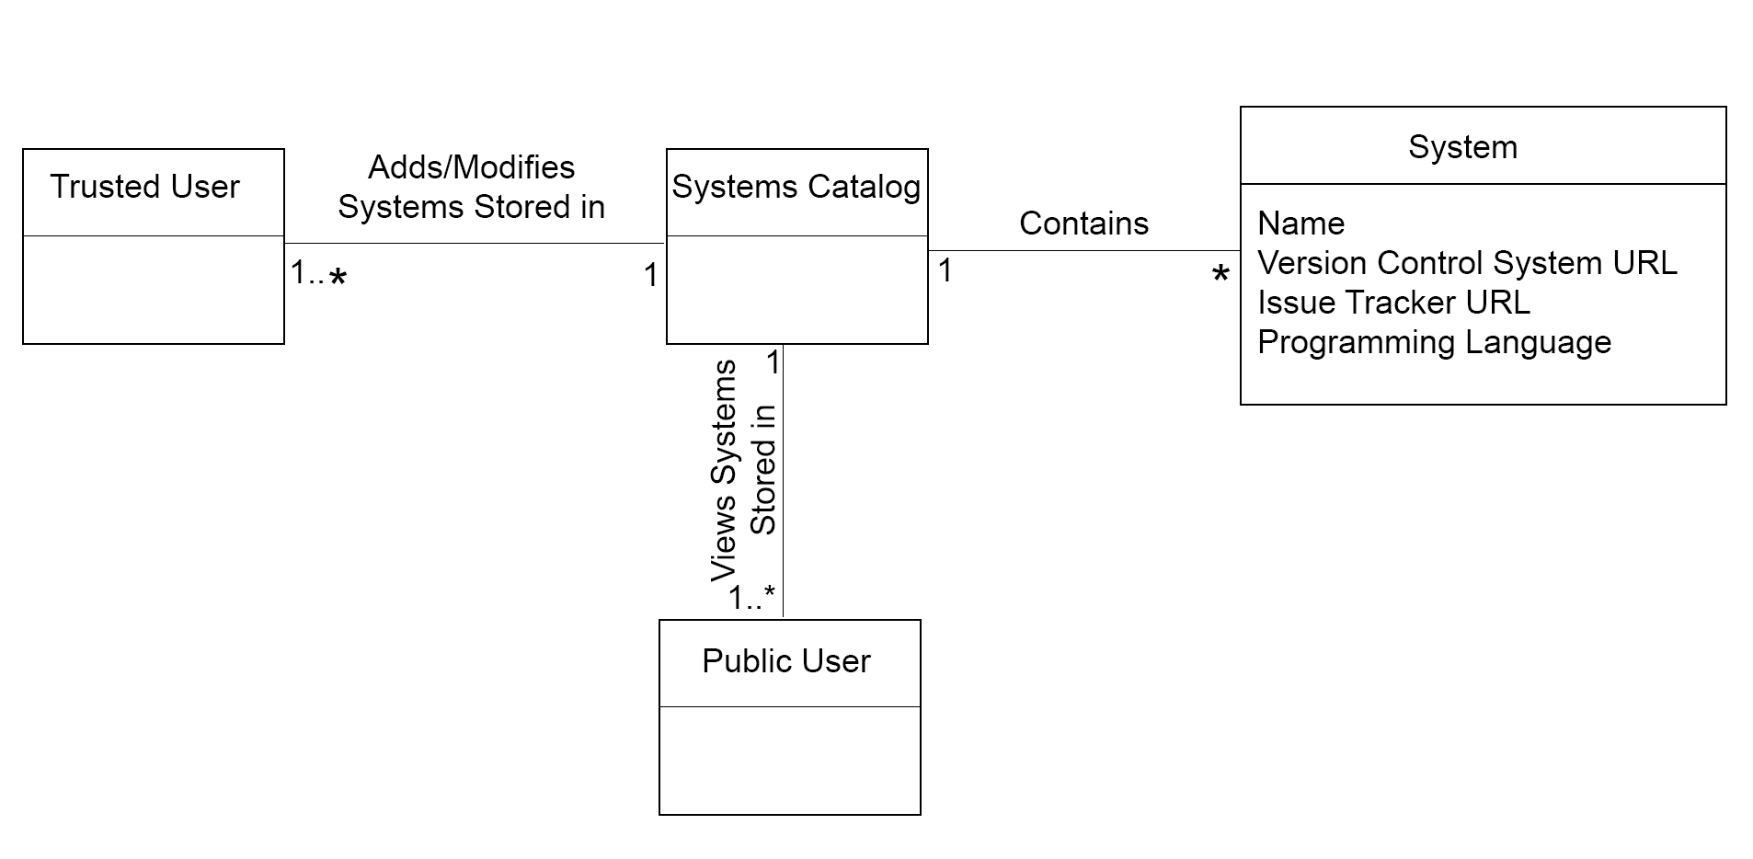
Domain Model

Slide 7
Use Case 3:
Add New System Release
Use Case UC-1: |  |  | Add New System
Related Requirements: |  |  | REQ1, REQ5, REQ7, REQ9, REQ11
Initiating Actor: |  |  | Any of: Trusted Users, Admin
Actor’s Goal: |  |  | To add release information for a system stored within the repository
Participating Actors: |  |  | Database, Admin, Trusted Users
Preconditions: |  |  | Trusted User/Admin is currently logged in the system and is shown a hyperlink “Add New System Release.”, Previous release of the system already exist within the System information table
Postconditions: |  |  | The newly added system release is now viewable to all visitors of the site
Flow of Events for Main Success Scenario:
→ | 1. | Trusted User/Admin clicks the hyperlink “Add New System Release”
← | 2. | System prompts the Trusted User/Admin for the System Name and System Release of the System
→ | 3. | Trusted User/Admin enters the system information and clicks submit
← | 4. | System verifies that a previous release of the system is present within the “System Information” table
← | 5. | System updates the records of the “System Release” table in the Database
→ | 6. | System displays the updated information on the “View Systems” page

Slide 8
Use Case 2:
View System Releases
Use Case UC-1: |  |  | Add New System
Related Requirements: |  |  | REQ4, REQ6, REQ8, REQ10, REQ12
Initiating Actor: |  |  | Any of: Trusted Users, Public Users, Admin
Actor’s Goal: |  |  | To view information about the release of a system stored within the repository
Participating Actors: |  |  | Database, Admin, Trusted Users, Public Users
Preconditions: |  |  | Trusted User/Admin/Public User currently has access to the system and is shown a “View System Release” Hyperlink
Postconditions: |  |  | The systems information table of the database is viewable to all visitors of the site
Flow of Events for Main Success Scenario:
→ | 1. | Trusted User/Admin/Public User clicks the hyperlink “View System Release”
→ | 2. | System displays the most up to date information on the “View System Release” page

Slide 9
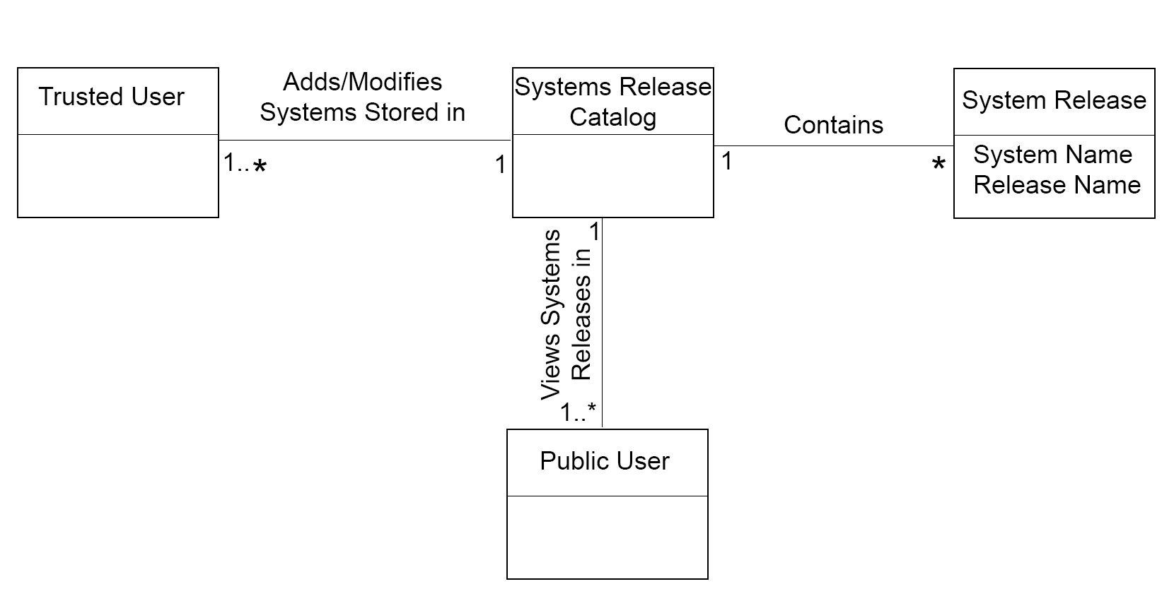
Domain Model

Slide 10
Use Case 1: Unlock
Use Case UC-7: |  |  | Add A New Revision
Related Requirements: |  |  | UC1, UC3, UC5, UC9 and UC11
Initiating Actor: |  |  | Admin and Privileged User
Actor’s Goal: |  |  | To add a new report in the system that has a name, ID, and section for comments
Participating Actors: |  |  | Repository
Preconditions: |  |  | • There must be a name of the system • There must be a ID of the report
Postconditions: |  |  | The report is added with a corresponding ID to the system
Flow of Events for Main Success Scenario:
→ | 1. | Admin or Privileged User
 | 2. | include::Authenticate User (UC-7)
← | 3. | There must be a name and ID of report
← | 4. | The report is added correctly in the system

Slide 11
Use Case UC-8: |  |  | Show Revision
Related Requirements: |  |  | UC2,UC4, UC6, UC10 and UC12
Initiating Actor: |  |  | Admin, Privileged or Non Privileged User
Actor’s Goal: |  |  | View the Revision Report
Participating Actors: |  |  | Repository
Preconditions: |  |  | • There must be a name of the system • There must be a ID of the report
Postconditions: |  |  | The report is shown in the screen with the correct information
Flow of Events for Main Success Scenario:
→ | 1. | Admin, Privileged or Non Privileged User
 | 2. | include::AuthenticateUser (UC-8)
← | 3. | There must be a name and ID of report
← | 4. | The report and correct information is shown in the screen
Use Case 1: Unlock

Slide 12
Use Case UC-9: |  |  | Add A New Target File
Related Requirements: |  |  | UC1, UC3, UC5, UC7 and UC11
Initiating Actor: |  |  | Admin or Privileged User
Actor’s Goal: |  |  | Add A New Target File
Participating Actors: |  |  | Repository
Preconditions: |  |  | • There must be a name of the system • There must be a release name • There must be a report ID • There must be a File Path • There must be a Revision Status • There must be a Change Type
Postconditions: |  |  | A correct Target File is added
Flow of Events for Main Success Scenario:
→ | 1. | Admin, Privileged or Non Privileged User
 | 2. | include::AuthenticateUser (UC9)
← | 3. | Click the drop down list next to “System Name” and select the system you would like to use. If it does not exist then you need to click the “Add new system” link to the right to add a new system. If you have to add a new system you need to fill out the form the “System Manager” form that shows up and then click “Add System”.
 | 4. | Click the drop down list next to “Release Name” and select the release you would like to use. If it does not exist, you need to click the “Add new system release” link to the right to add a new release. If you have to add a new system you need to fill out the “System Manager” form that shows up and then click “Add System Release”.
 | 5. | Click the drop down list next to “Report Id” and select the release you would like to use. If it does not exist, you need to click the “Add new report” link to the right to add a new release. If you have to add a new report you need to fill out the “Report Manager” form that shows up and then click “Add Report”.
 | 6. | Copy and paste the exact file path into the text box next to “File Path”.
 | 7. | Click the drop down list next to “Revision” and select the revision number that you want. If it does not exist, you need to click the “Add new revision” link to the right to add a new revision. If you have to add a new revision, you need to fill out the “Revision Manager” form that shows up and then click “Add Revision”.
 | 8 | Click the drop down list next to “Change Type” and select the option added, modified, or deleted depending on which action you completing.
 | 9. | Click the “Add Target File” button to complete your action.
← | 10. | To make sure that your file was added correctly, On the home page click the “Show target files” link. You should then be able to see if the “Target File” was properly added into the system.

Slide 13
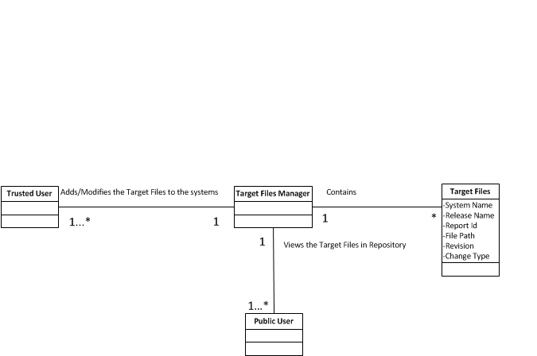
Add a new Target File

Slide 14
Use Case UC-10: |  |  | Show A New Target File
Related Requirements: |  |  | UC2, UC4, UC6, UC8 and UC12
Initiating Actor: |  |  | Admin, Privileged User or Non Privileged User
Actor’s Goal: |  |  | Show A new Target File
Participating Actors: |  |  | Repository
Preconditions: |  |  | • There must be a name of the system • There must be a release name • There must be a report ID • There must be a File Path • There must be a Revision Status • There must be a Change Type
Postconditions: |  |  | A correct Target File is shown in the Screen
Flow of Events for Main Success Scenario:
→ | 1. | Admin, Privileged or Non Privileged User
 | 2. | include::AuthenticateUser (UC9)
 | 3. | Go to the home page that shows all the links to the repository.
 | 4. | Click on the “Show target files” link under the Target Files heading.
 | 5. | A list should appear and your added file should be listed.

Slide 15
Use Case UC-11: |  |  | Add A New Target File (Change Manager)
Related Requirements: |  |  | UC1, UC3, UC5, UC7 and UC11
Initiating Actor: |  |  | Admin or Privileged User
Actor’s Goal: |  |  | Add A New Target File (Change Manager)
Participating Actors: |  |  | Repository
Preconditions: |  |  | • There must be a name of the system • There must be a release name • There must be a report ID • There must be a File Path • There must be a Granularity Type • There must be a Change Type
Postconditions: |  |  | A correct Target File is added
Flow of Events for Main Success Scenario:
→ | 1. | Admin, Privileged or Non Privileged User
 | 2. | include::AuthenticateUser (UC9)
← | 3. | Click the drop down list next to “System Name” and select the system you would like to use. If it does not exist then you need to click the “Add new system” link to the right to add a new system. If you have to add a new system you need to fill out the form the “System Manager” form that shows up and then click “Add System”.
← | 4. | Click the drop down list next to “Release Name” and select the release you would like to use. If it does not exist, you need to click the “Add new system release” link to the right to add a new release. If you have to add a new system you need to fill out the “System Manager” form that shows up and then click “Add System Release”.
 | 5. | Click the drop down list next to “Report Id” and select the release you would like to use. If it does not exist, you need to click the “Add new report” link to the right to add a new release. If you have to add a new report you need to fill out the “Report Manager” form that shows up and then click “Add Report”.
 | 6. | Click the drop down list next to “File Path” and select the file path you would like to use. If it does not exist, you need to click the “Add new report” link to the right to add a new release. IF you have to add a new report you need to fill out the “Target File Manager” form that shows up and then click “Add Target File”.
 | 7. | Click the drop down list next to “Granularity” and select the class or method.
 |  | Click inside the text box next to “Qualified name” and enter a valid name.
 | 8 | Click the drop down list next to “Change Type” and select the option added, modified, or deleted depending on which action you completing.
 | 9. | Click the “Add Change” button to complete your action.
 | 10. | To make sure that your file was added correctly, On the home page click the “Show target files” link. You should then be able to see if the “Target File” was properly added into the system.

Slide 16
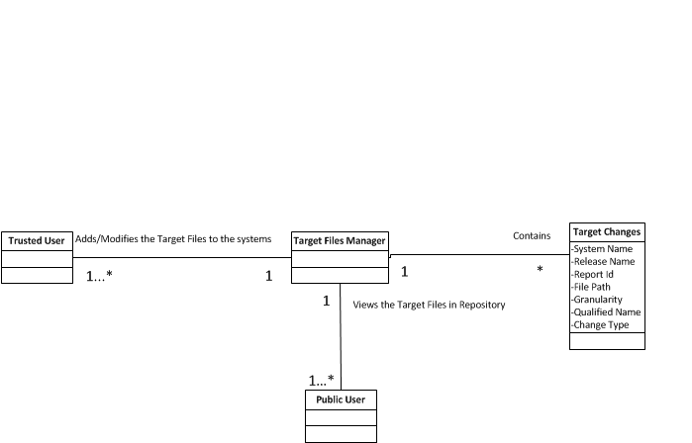
Add a new Target File (Change Manager)

Slide 17
Use Case UC-12: |  |  | Show A New Target File (Change Manager)
Related Requirements: |  |  | UC2, UC4, UC6, UC8 and UC10
Initiating Actor: |  |  | Admin, Privileged User, or Non Privileged User
Actor’s Goal: |  |  | Show A New Target File (Change Manager)
Participating Actors: |  |  | Repository
Preconditions: |  |  | • There must be a name of the system • There must be a release name • There must be a report ID • There must be a File Path • There must be a Granularity Type • There must be a Change Type
Postconditions: |  |  | A correct Target File is Shown
Flow of Events for Main Success Scenario:
→ | 1. | Admin, Privileged or Non Privileged User
 | 2. | include::AuthenticateUser (UC9)
← | 3. | Go to the home page that shows all the links to the repository.
← | 4. | Click on the “Show target files” link under the Target Files heading.
 | 5. | A list should appear and your added file should be listed.

Slide 18
Use Case UC-14: |  |  | Remove A User
Related Requirements: |  |  | UC 14
Initiating Actor: |  |  | Admin
Actor’s Goal: |  |  | Delete a User
Participating Actors: |  |  | Repository
Preconditions: |  |  | The User must exist in the system
Postconditions: |  |  | User Deleted
Flow of Events for Main Success Scenario:
→ | 1. | Admin
 | 2. | include::AuthenticateUser (UC9)
← | 3. | There must be a user
← | 4. | User Deleted

Slide 19
Use Case UC-14: |  |  | Add A User
Related Requirements: |  |  | UC 13
Initiating Actor: |  |  | Admin
Actor’s Goal: |  |  | Add a User
Participating Actors: |  |  | Repository
Preconditions: |  |  | The User must not exist in the system
Postconditions: |  |  | User Added
Flow of Events for Main Success Scenario:
→ | 1. | Admin
 | 2. | include::AuthenticateUser (UC9)
← | 3. | There must be a user
← | 4. | User Added

Slide 20
Where we are at
Edited our previous domain model to better understand the project
Pulled all existing html and css from the legacy website to use as a starting template
Setup development environments (IntelliJ, Apache Tomcat)
Setup Github accounts
Did research for using the Spring framework for the login and functions for pages.

Slide 21
Things to do
Next Iteration 9/30-10/6:
Create UI of the pages for Users (HTML,CSS/Twitter Bootstrap) based off of the current template
Setup MySQL Database and define the relationships between the entities in our domain model

Slide 22
Hang-ups
We had a few issues with beginning development because of a misunderstanding with our domain model.

Slide 23
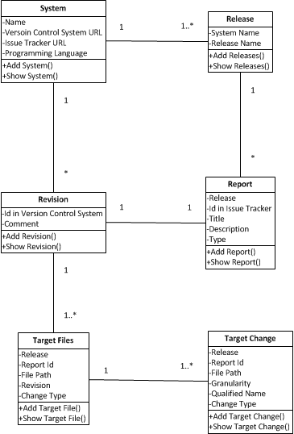
Class Diagram

Slide 24
Admin Role
Admin can add or remove trusted users, add/modify/view/download data from the repository
Primary actor:
Admin User
Actor’s goals:
Adding or removing trusted users, modifying/adding/viewing/downloading of information about a System, System release, Report, Revision, Target file, or Target changes from one of the database tables
Preconditions:
Data should be available within the system
Data is correct/has been verified
Main tasks:
Add/Remove trusted users from the system
Reset login credentials
Add/View information about the systems currently within the repository (Name, Version Control System URL, Issue Tracker URL, Programming Language)
Add/View information about the release of the system (System Name, Release name)
Add/View reports (System Name, Release Name, Id in Issue Tracker, Type i.e. Bug/Update, Report Title)
Add/View revisions (System Name, Id in VCS, Comments)
Add/View target file changes/updates (System Name, Release name, Report Id, File path, Change type, Revision)
Add/View target Changes (System name, Release Name, Report Id, Granularity i.e. Method/Class, Qualified name i.e. hierarchical name of the object, function, or variable)
Post-conditions:
User is either added to the system or removed
Data is correct/has been verified
Data is available for viewing/downloading by the public

Slide 25
Trusted User Role
Trusted users can add/modify/view/download data from the repository
Primary actor:
Trusted users
Actor’s goals:
Modifying/adding/viewing/downloading of information about a System, System release, Report, Revision, Target file, or Target changes from one of the database tables
Preconditions:
Data should be available within the system
Data is correct/has been verified
Main tasks:
Add/View information about the systems currently within the repository (Name, Version Control System URL, Issue Tracker URL, Programming Language)
Add/View information about the release of the system (System Name, Release name)
Add/View reports (System Name, Release Name, Id in Issue Tracker, Type i.e. Bug/Update, Report Title)
Add/View revisions (System Name, Id in VCS, Comments)
Add/View target file changes/updates (System Name, Release name, Report Id, File path, Change type, Revision)
Add/View target Changes (System name, Release Name, Report Id, Granularity i.e. Method/Class, Qualified name i.e. hierarchical name of the object, function, or variable)
Post-conditions:
Data is correct/has been verified
Data is available for viewing/downloading by the public

Slide 26
Public User Role
Public user can view/download data from the repository
Primary actor:
Public users who do not have data modification/adding privileges
Actor’s goals:
Viewing/downloading of information about a System, System release, Report, Revision, Target file, or Target changes from one of the database tables
Preconditions:
Data should be available within the system
Data is correct/has been verified
Main tasks:
View information about the systems currently within the repository (Name, Version Control System URL, Issue Tracker URL, Programming Language)
View information about the release of the system (System Name, Release name)
View reports (System Name, Release Name, Id in Issue Tracker, Type i.e. Bug/Update, Report Title)
View revisions (System Name, Id in VCS, Comments)
View target file changes/updates (System Name, Release name, Report Id, File path, Change type, Revision)
View target Changes (System name, Release Name, Report Id, Granularity i.e. Method/Class, Qualified name i.e. hierarchical name of the object, function, or variable)

Slide 27
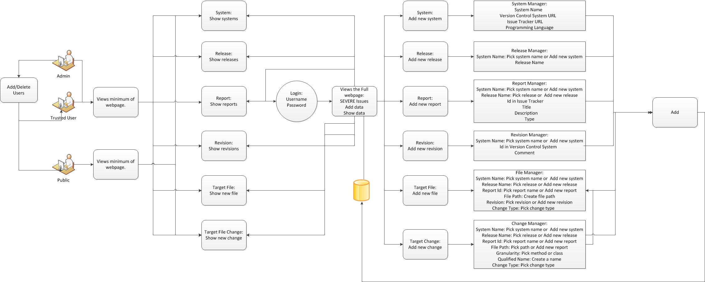
Data Flow Diagram

Slide 28
Resources:
Cleints website:
http://35.16.37.38:8080/severe-issues/
Bootstrap
http://getbootstrap.com/
DesignDocuments/JavaTutorials:
http://www.youtube.com/user/derekbanas/videos?view=1&flow=grid
Spring, Hibernate, Spring MVC:
http://www.youtube.com/user/koushks/videos?view=1&flow=grid
HTML,CSS3,JavaScript:
http://thenewboston.org/tutorials.php

